Slide 1
Ido Aviv Memorial- Soldiers Surf free Ofek Yabo, Dolev David, Segev Olpak, Guy Yehoshua
Software Engineering
Faculty of Engineering
Ben Gurion University of the Negev

Slide 2
Project’s Description
A Public surfboard lending website for soldiers, in memory of IDF combat Ido Aviv
full-stack system
A website for soldiers to register & reserve a surfboard.
Dynamic Backend for different objects lending.
Many distributed sites at Israeli beaches.
Embedded hardware integration (lockers, sensors)
Notes:
Problems we solve: A flexible system that manages entities, manages users and permissions, monitors the status of equipment in real time, allows for expansion and addition of objects, maintains the security of users' information, interfaces to work with sensors and physical hardware components, and finally interfaces to work through the WIX website in a convenient way. In addition, a unique scan of the soldier's card will be used to verify his identity - something that is already registered in a patent that is unique to this project.

Slide 3
Motivation
Ido’s death, continue his way of life:
אתה חייל? בטח אחי קח גלשן, סומך עליך
Ambition to make scale largely:
allow more families to commemorate their fallen
expand to reach more soldiers
Learn new abilities and create an end product to admire.
Sentimental value to the project.
Notes:
The project took shape after Ido's death in the war by Gil Horowitz and Ido's family, who were looking for ways to commemorate him in a way that best suited Ido. Ido used to say: "Take a surfboard, I trust you."
The problem is that the project was built in a very specific way and is not suitable for expansion.
Our ambition is that the entire project will be in memory of Ido, and in cooperation with municipalities we will be able to place additional cabinets throughout the country, thus commemorating the city's loved ones who were connected to the sea throughout the country using the platform we will create for Ido.

Slide 4
Goals
Management and monitoring
Combine sensors to surfboards and cabinets
Admin tools to monitor & manage
Distribution
Many surfboards
Many cabinets
Many sites
Expansion
Option to add and manage more items & sites
Option to manage other kinds of items & storage.

Slide 5
System Requirements
Requirements
ARD

Slide 6
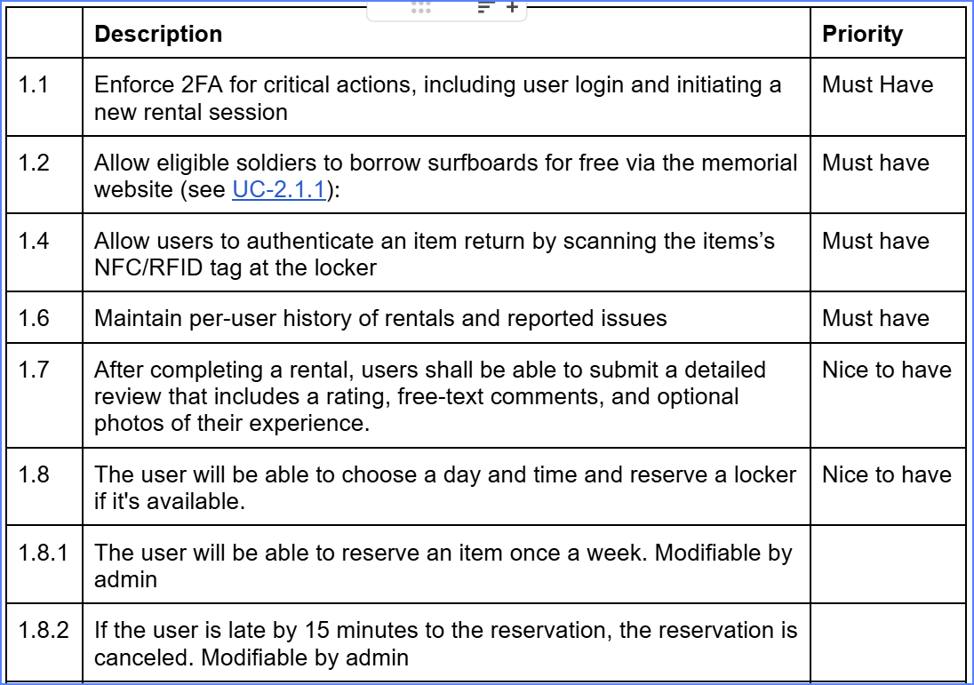
Server - user related

Slide 7
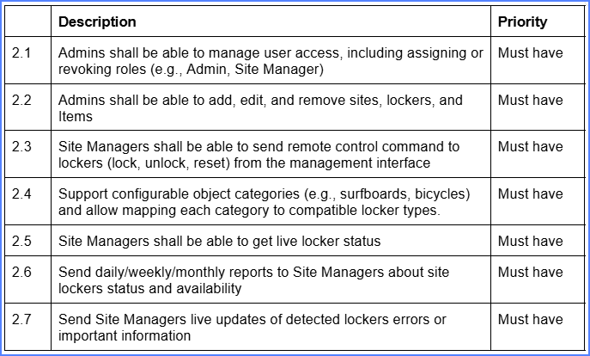
Server - management related

Slide 8
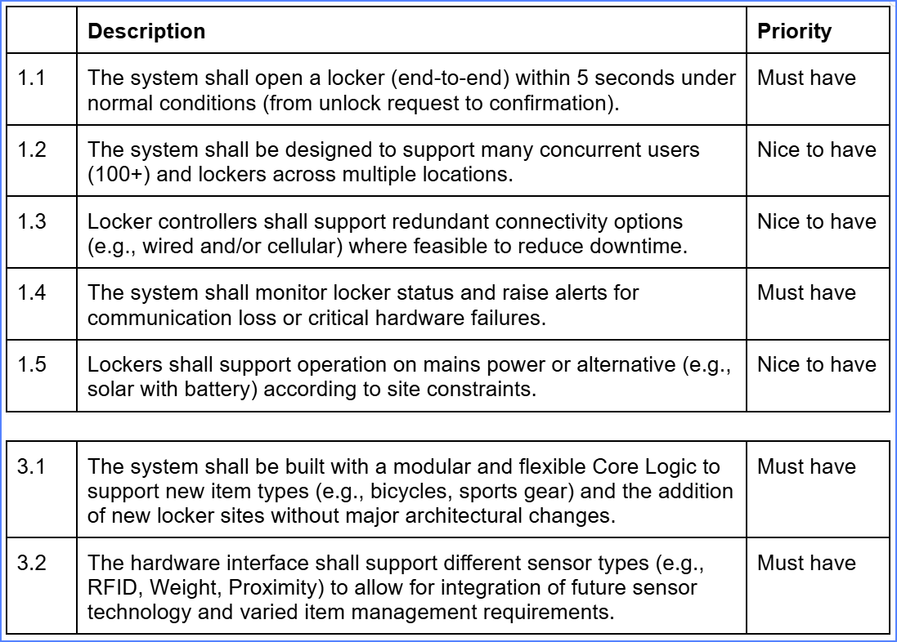
Performance & Reliability & Modularity

Slide 9
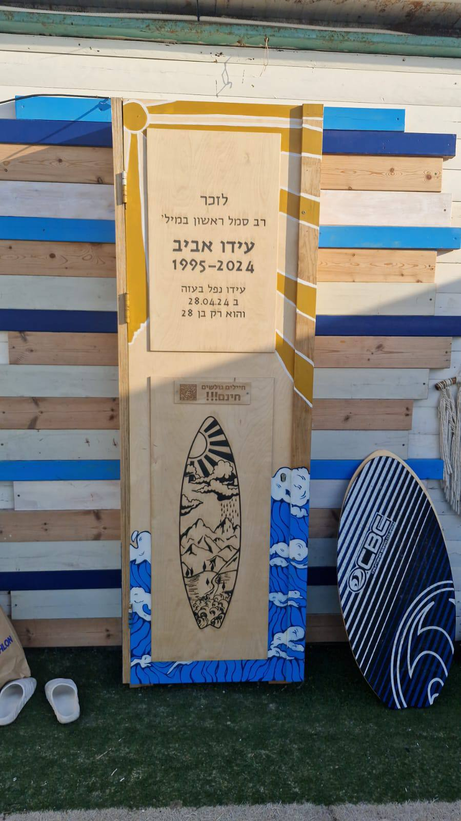
The Project’s Status Today
Memorial site for Ido Aviv - Link
Surf club site (rent)- Link
Prototype cabinet
Cloud Diagram

Slide 10
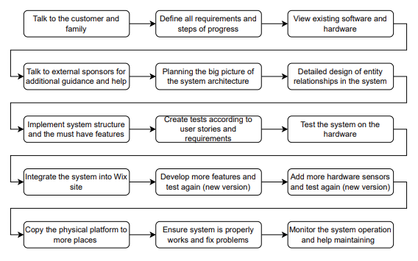
Future Plan

